Slide 1
Bioengineering Lecture 1: Biostatistics Primer
William Okech, PhD (Instructor)
2025

Slide 2
Outline
Class Logistics
Biological Data and Biostatisticians
Basic Biostatistical Concepts
Required Readings

Slide 3

Outline
Class Logistics
Biological Data and Biostatisticians
Basic Biostatistical Concepts
Required Readings

Slide 4
Class Policies
Expectations: To ensure a safe learning environment please treat each other with respect.
Attendance: Course is run using an in-person format and attendance is mandatory unless explicit permission is obtained from the instructor.
Assignments: Late homework and lab reports will not be accepted unless extensions have been requested in advance.

Slide 5
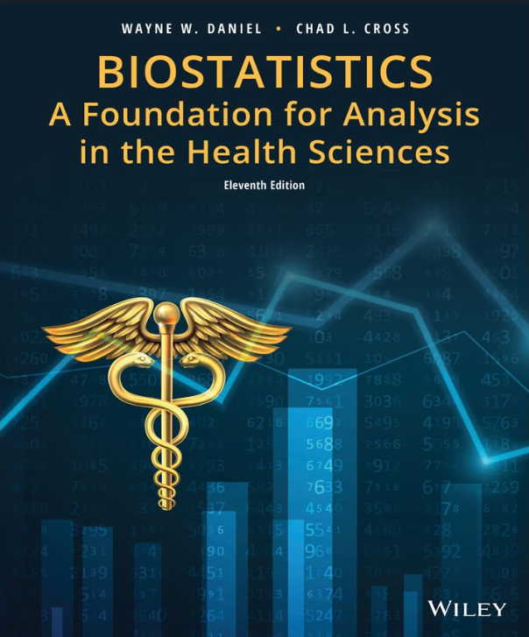


Reference Textbooks
Reference texts are available online and/or in the library.

Slide 6

Outline
Class Logistics
Biological Data and Biostatisticians
Brief overview of Basic Biostatistical Concepts
Required Readings

Slide 7











Biological Data is Everywhere!
Notes:
As most of us know, biological data is everywhere.
Common sources of data include Routinely kept records / Surveys / Experiments / Reports
The various biological datasets include:
Government and Public Health Repositories
Genomic and Molecular Data databases
Clinical Trial Databases
Electronic Health Records
Research Initiative databases
Environmental and Ecological Databases
International Health Databases

Slide 8
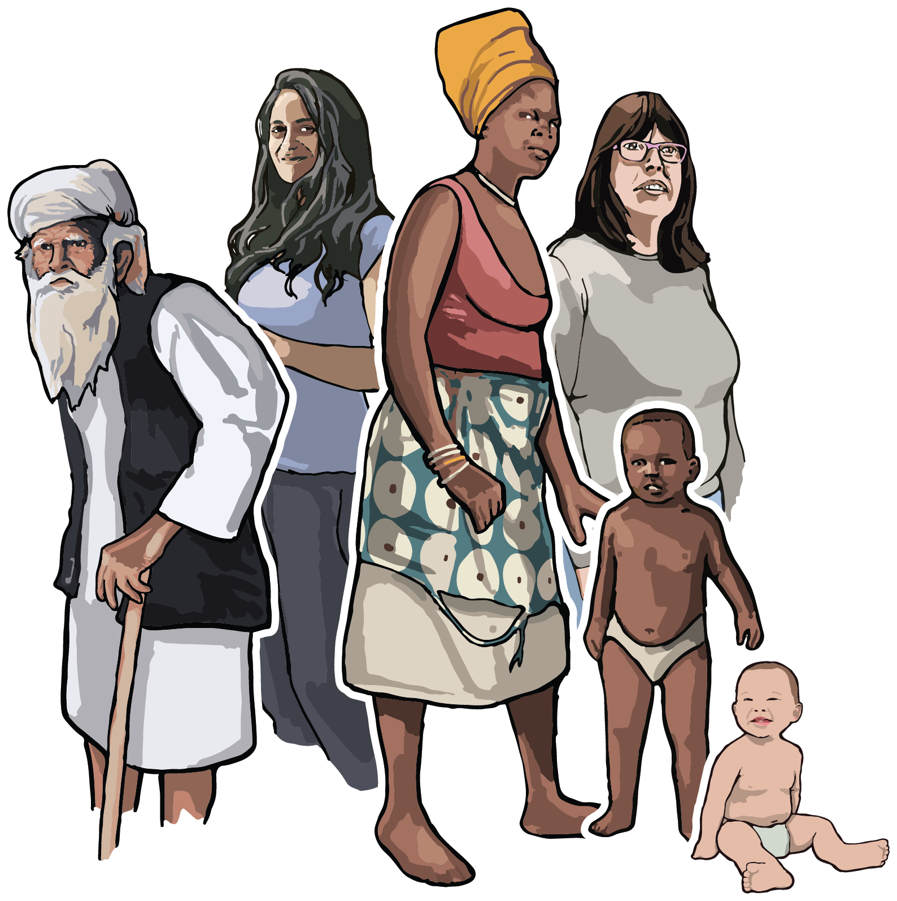




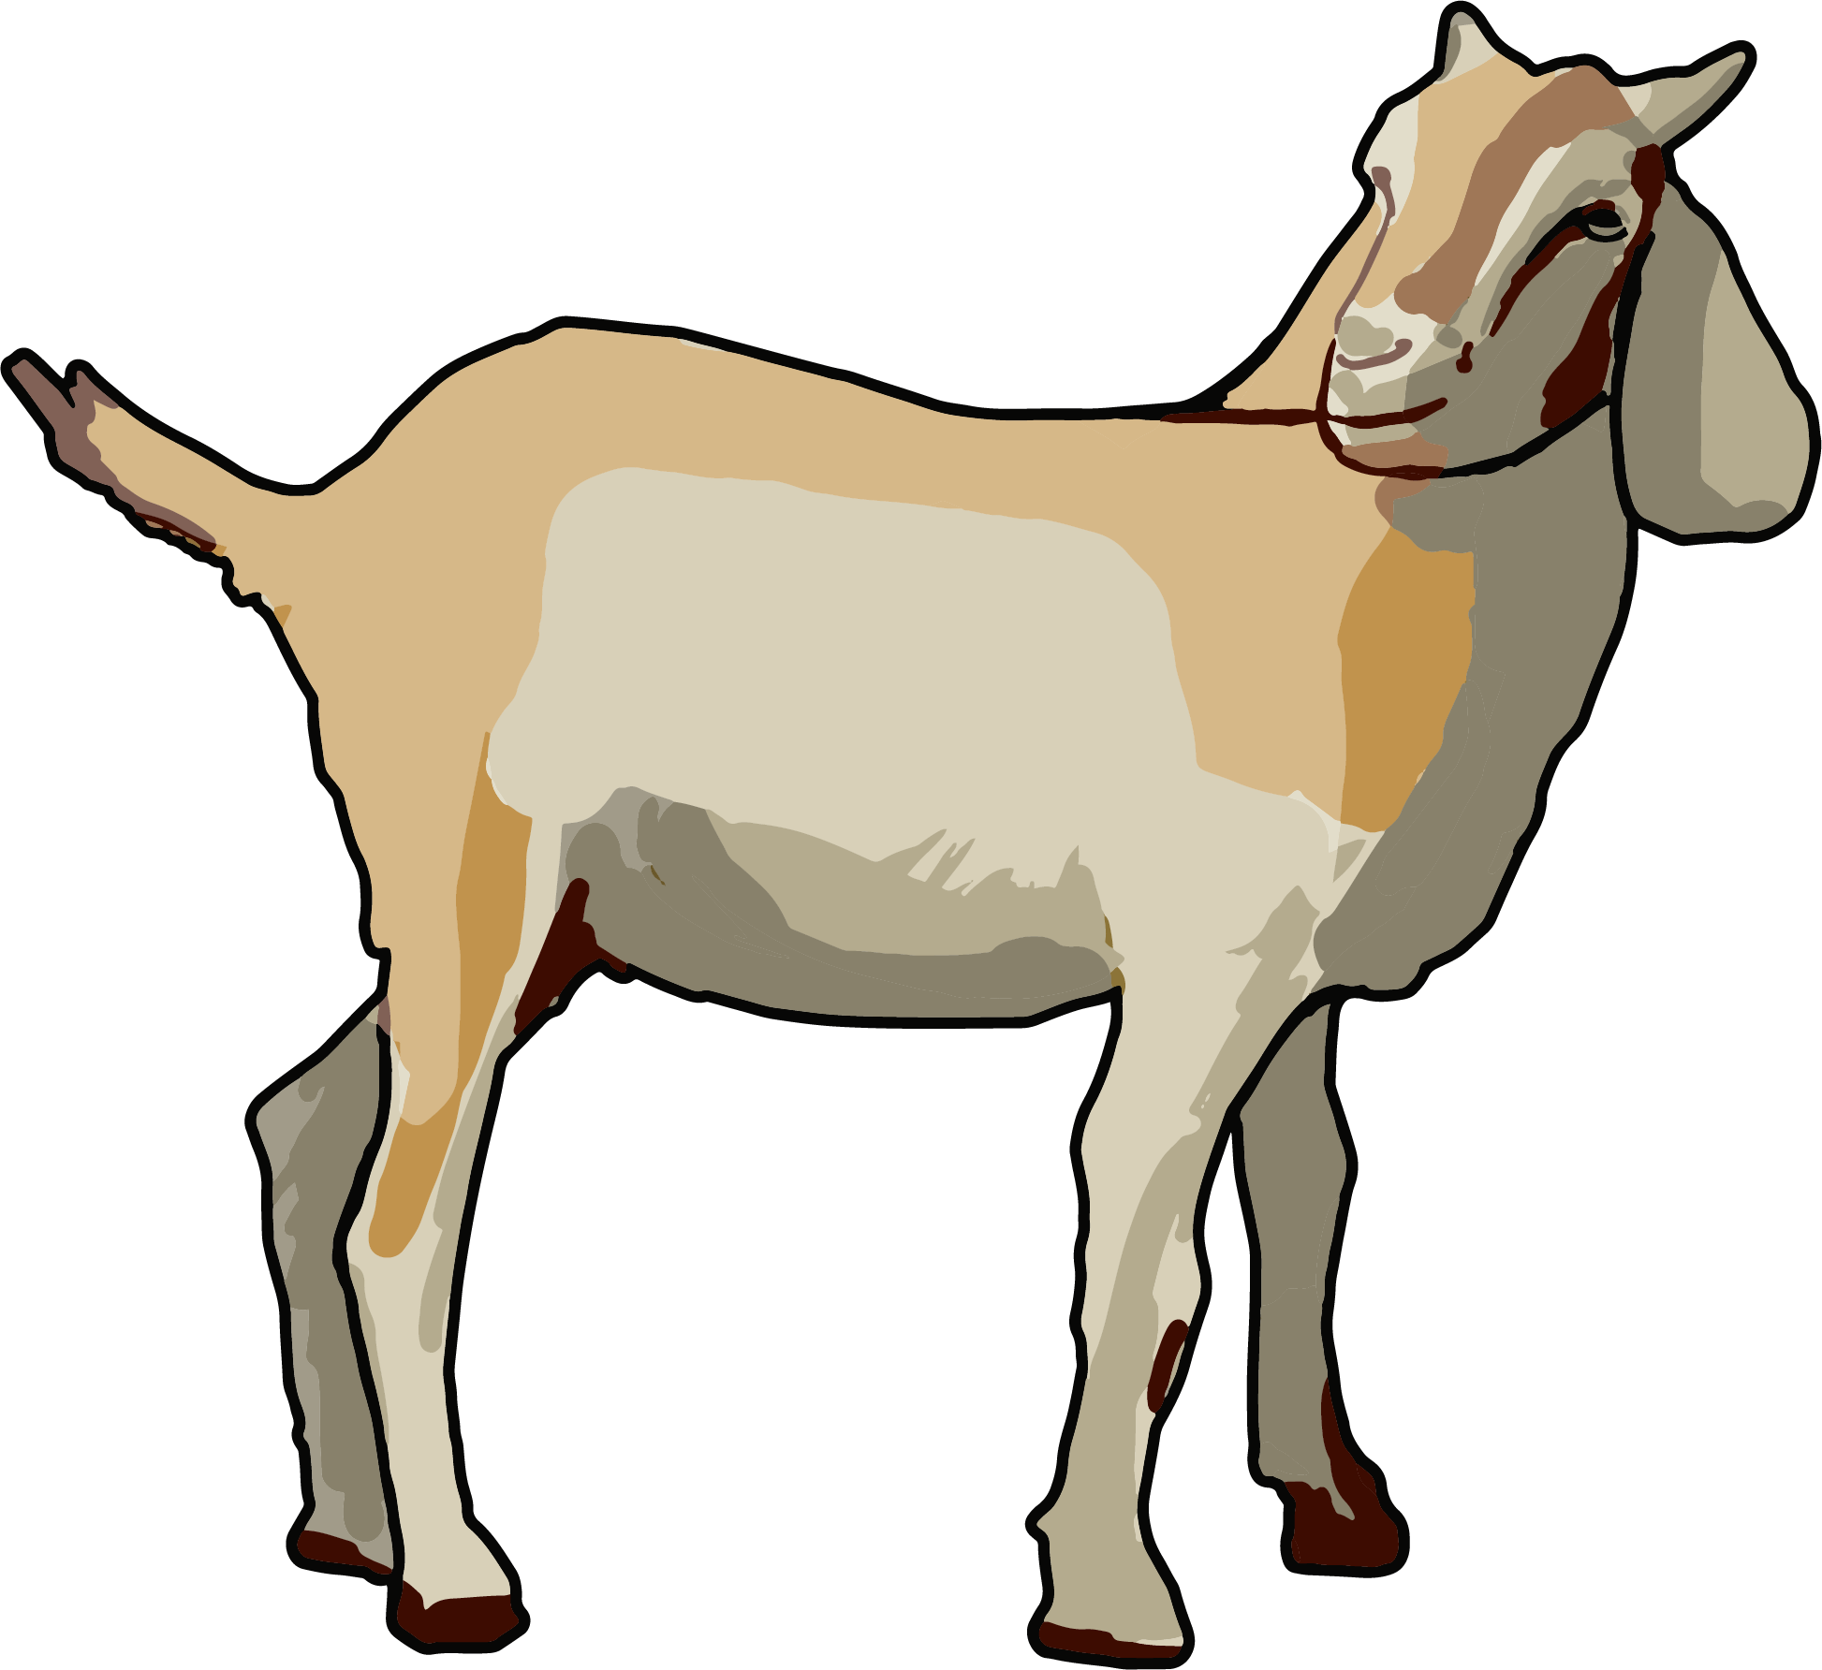
How is this data collected?
Scientists and
Clinicians
Data Analysts
Biological Samples
BIOSTATISTICIANS
Note: Images obtained from https://bioart.niaid.nih.gov/

Slide 9
What is the role of a biostatistician?
A biostatistician “develops, implements, and applies statistical methods to analyze and interpret data in the fields of biology, medicine, and public health.”
Employment
Academic and Clinical Research Labs
Healthcare NGOs
Pharmaceutical and Medical Device Companies
Government Public Health Departments
Specific Tasks
Design studies and clinical trials to address specific scientific questions.
Develop stringent methodologies for collecting data.
Supervise collection and analysis of data sets.
Interpret results and assist with writing papers, reports and presentations
1. Zapf, A., Rauch, G. & Kieser, M. Why do you need a biostatistician?. BMC Med Res Methodol 20, 23 (2020).
2. What is a biostatistician? 2025 career guide. Coursera. https://www.coursera.org/articles/biostatistician

Slide 10
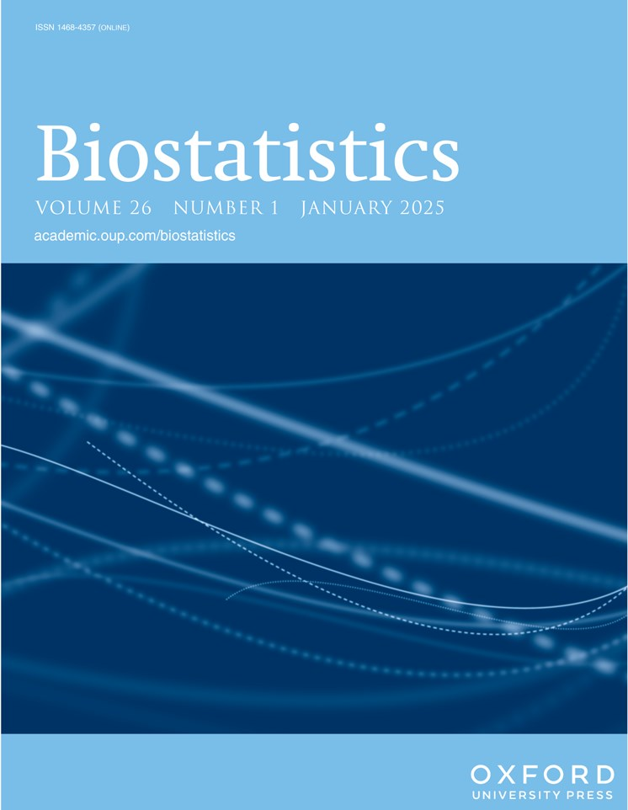

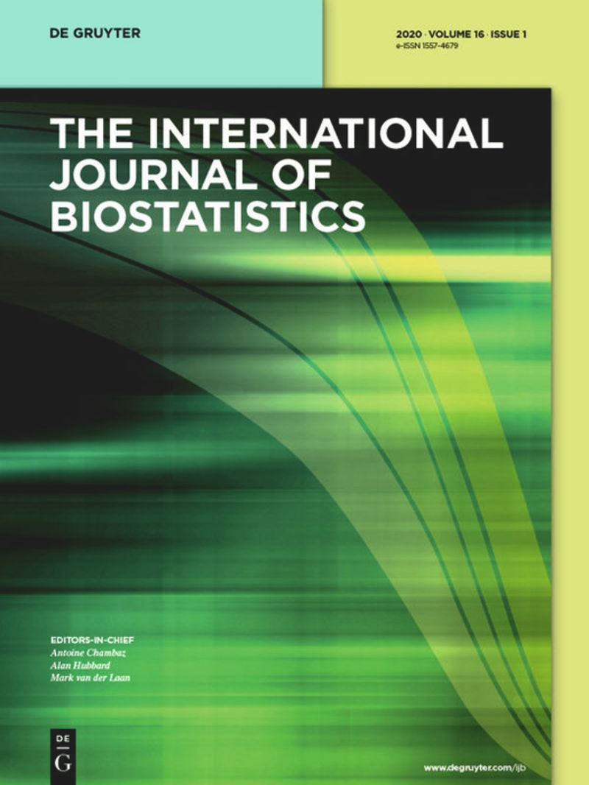




Where is the data published?
Note: Images obtained from respective journal/publication websites
Notes:
So where is the data published?
Peer-Reviewed Journals
Government Reports
Systematic Reviews/Meta-Analyses
Industry White Papers

Slide 11
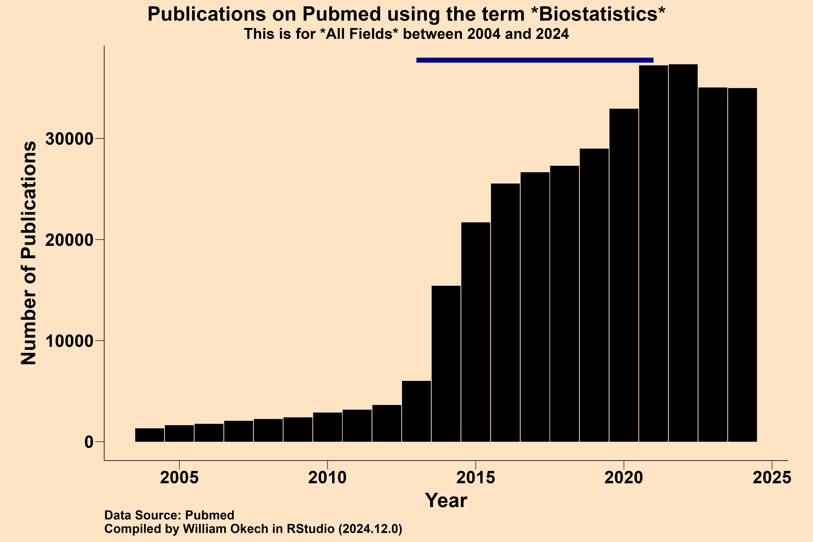
Yearly Biostatistics Publications
Data Source: Pubmed (https://pubmed.ncbi.nlm.nih.gov/)

Slide 12
Outline
Class Logistics
Biological Data and Biostatisticians
Basic Biostatistical Concepts
Required Readings

Slide 13
Basic Biostatistical Concepts
Learning Objectives
Identify biological sources of data
Classify key data types
Provide examples of various data types

Slide 14
Basic Biostatistical Concepts
A. Sources of Data
Routinely Kept Records
Electronic Health Records
Crop Yield Records
Surveys
National Health and Nutrition Examination Survey (NHANES)
Demographic and Health Survey (DHS)
Food Insecurity Experience Scale
Experiments
Laboratory Experiments
Crop Field Trials
Reports and Publications
Peer-reviewed Journals and Systematic Reviews
Government Reports and White Papers
Daniel, W. W., & Cross, C. L. (2018). Biostatistics: A Foundation for Analysis in the Health Sciences.

Slide 15
Basic Biostatistical Concepts
B. Types of Data
Broadly classified into two types:
Quantitative (Numerical) Data
Represents quantities or measurements that can be counted or measured numerically.
With this data we ask “how much?”
Qualitative (Categorical) Data
Describes non-numerical attributes such as qualities, characteristics, or categories.
With this data we ask “what type?”
Daniel, W. W., & Cross, C. L. (2018). Biostatistics: A Foundation for Analysis in the Health Sciences.

Slide 16
Basic Biostatistical Concepts
C. Quantitative (Numerical) Data
Measured (continuous) or counted (discrete) variables.
Measured | Counted
Age (years) Weight (pounds or kilograms) Height (centimeters or feet) | Number of positive COVID cases in a city Number of children enrolled in a school
Daniel, W. W., & Cross, C. L. (2018). Biostatistics: A Foundation for Analysis in the Health Sciences.
Notes:
For Quantitative data…

Slide 17
Basic Biostatistical Concepts
C. Qualitative (Categorical) Data
Nominal (unordered categories) or ordinal (ordered categories) variables.
Nominal | Ordinal
Race Zip Code Political Party Disease State (Yes / No) Blood Group (O, A, B, AB) | Socioeconomic status (“low income”, “middle income”, “high income”) Educational level (“high school diploma”, “bachelors”, “masters”, “doctorate”)
Daniel, W. W., & Cross, C. L. (2018). Biostatistics: A Foundation for Analysis in the Health Sciences.

Slide 18
Summary
Sources of Data
Routinely Kept Records
Surveys
Experiments
Reports and Publications
2. Types of Data
Quantitative / Numerical – “How much?”
Examples – Age, Weight, and Number of children enrolled in school
Qualitative / Categorical – “What type?”
Examples – Race, Political Party, and Education Level
Notes:
In summary we have seen that…

Slide 19
Outline for today’s class
Class Logistics
Biological Data and Biostatisticians
Basic Biostatistical Concepts
Required Readings

Slide 20
Required Readings
Klaus B. (2015). Statistical relevance--relevant statistics, part I. The EMBO journal, 34(22), 2727–2730. https://doi.org/10.15252/embj.201592958
Klaus B. (2016). Statistical relevance-relevant statistics, part II: presenting experimental data. The EMBO journal, 35(16), 1726–1729. https://doi.org/10.15252/embj.201694659

Slide 21
Outline
Class Logistics
Biological Data and Biostatisticians
Basic Biostatistical Concepts
Required Readings

Slide 22
References
PubMed: https://pubmed.ncbi.nlm.nih.gov/
Bioart NIH: https://bioart.niaid.nih.gov/
Daniel, W. W., & Cross, C. L. (2018). Biostatistics: A Foundation for Analysis in the Health Sciences. John Wiley & Sons.
Zapf, A., Rauch, G. & Kieser, M. Why do you need a biostatistician?. BMC Med Res Methodol 20, 23 (2020).
What is a biostatistician? 2025 career guide. Coursera. https://www.coursera.org/articles/biostatistician

